Slide 1

Hotel Management System
-by
1. Wani Pushpak Shrikant
43. Raut Atharva Satish
45. Savant Omkar Vitthal

Slide 2

Introduction
VB.NET
GUI
Hotel Management

Slide 3

VB.NET
VB.NET is a simple, modern, object-oriented computer programming language developed by Microsoft to combine the power of .NET Framework and the common language runtime.
Stable release: 2019 (16.0)

Slide 4

GUI
GUI stands for Graphical User Interface.
It is a form of user interface that allows users to interact with electronic devices.

Slide 5


Hotel Management
Managing a hotel comes with a range of responsibilities.
You must be able to adapt to new challenges, help different departments and ensure the hotel maintains a standard of excellence.

Slide 6

History
VB.NET
GUI
Hotel Management

Slide 7

VB.NET
It was Developed by Microsoft Corporation.
It was released in 2002.

Slide 8
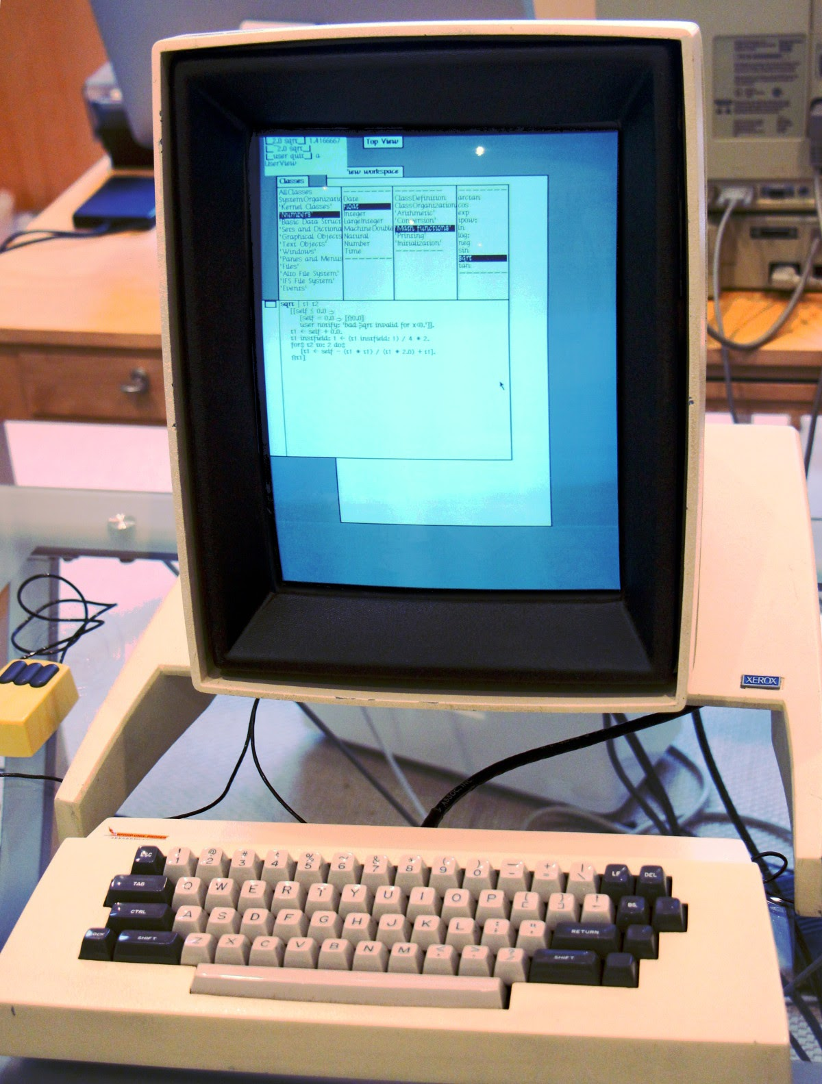
GUI
The graphical user interface, developed in the late 1970s by the Xerox Palo Alto research laboratory
Later it was deployed commercially in Apple's Macintosh and Microsoft's Windows operating systems.

Slide 9
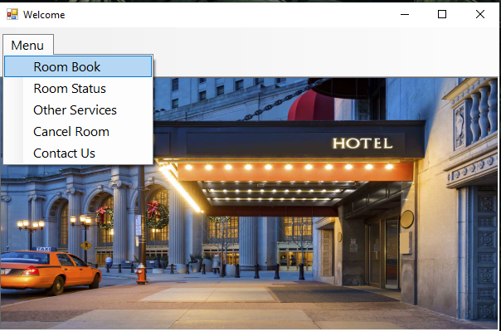
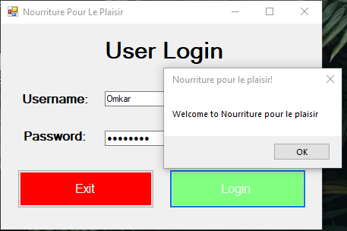
Output

Slide 10
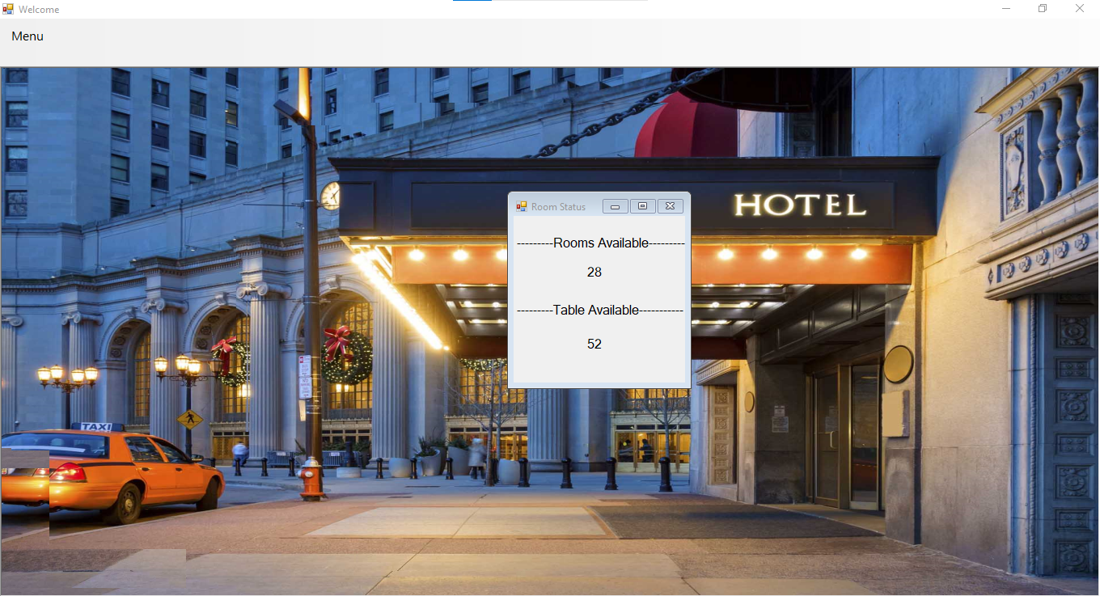
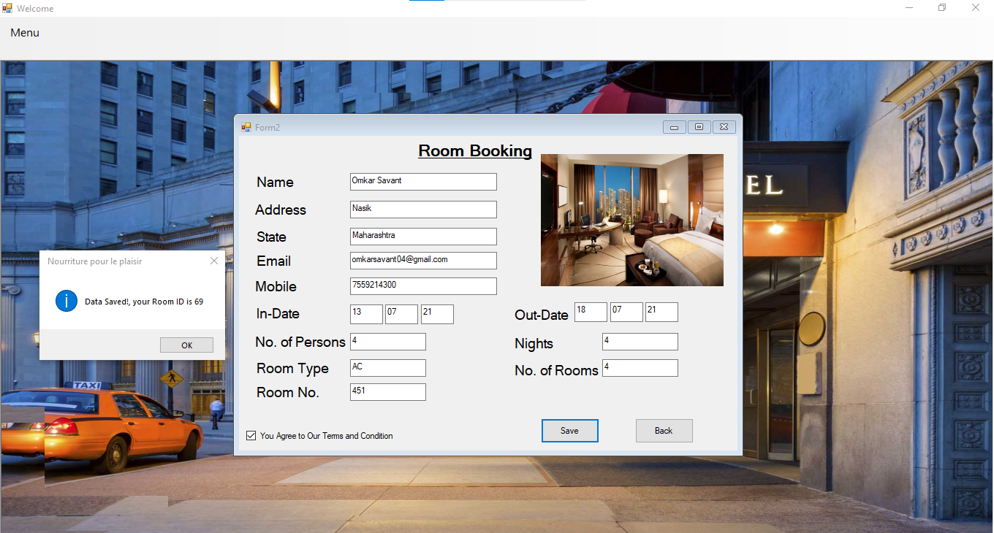
Output

Slide 11
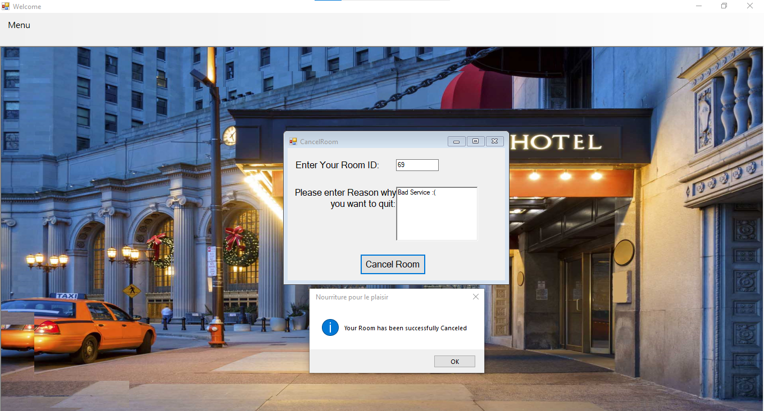
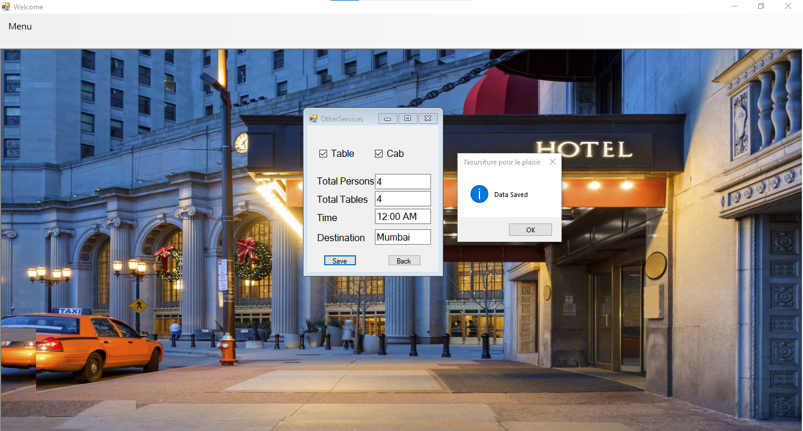
Output

Slide 12
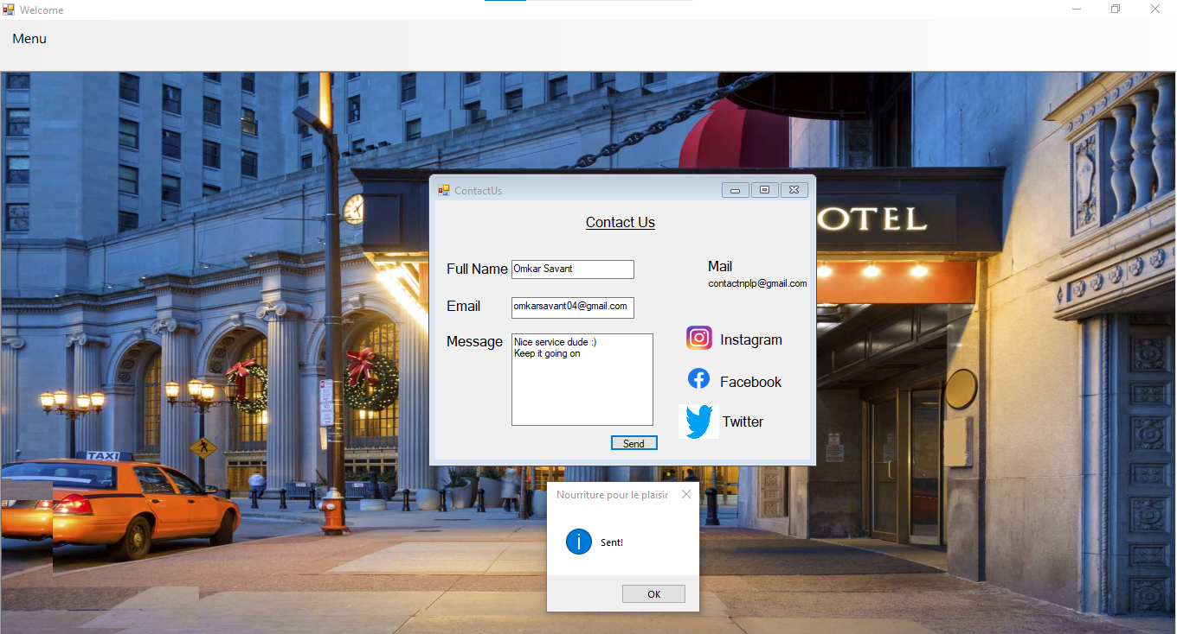
Output

Slide 13

Conclusion
VB.NET was developed by Microsoft which was successor to Visual Basic.
Graphical User Interface makes it easier for user to interact with the software.
A hotel management is a confident approach in software as it inherits the importance of teamwork into the project.

Slide 14
Thank You

